Slide 1
Design and Analysis of Algorithms
Algorithms-II : CS345A
Lecture 32
Fast Matrix Multiplication
I
and its Applications

Slide 2
Algorithms for
Fast Matrix Multiplication

Slide 3

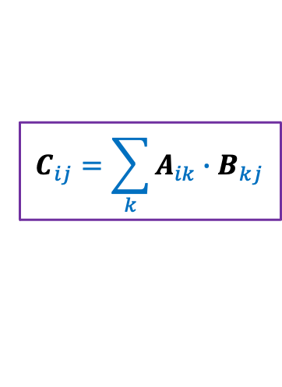
Multiplication of Matrices
2 | 3 | 0 | 3 | 7
8 | 0 | 9 | 7 | 1
0 | 0 | 4 | 0 | 0
0 | 8 | 0 | 1 | 0
5 | 3 | 0 | 5 | 0
6 | 0 | 7 | 0 | 0
0 | 9 | 8 | 0 | 7
3 | 2 | 9 | 1 | 0
6 | 1 | 8 | 9 | 0
1 | 0 | 4 | 6 | 0
A
B
C
$$C_{ij}=\sum_{k}{A_{ik}{∙B}_{kj}}$$
Time complexity: O$(n^{3})$ time .
But faster algorithms exist for more than 50 years.

Slide 4
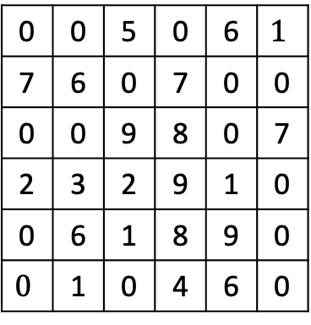
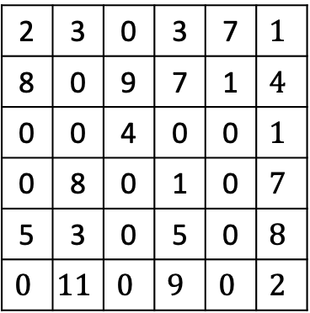
Fast Matrix Multiplication
2 | 3 | 0 | 3 | 7 | $$1$$
8 | 0 | 9 | 7 | 1 | $$4$$
0 | 0 | 4 | 0 | 0 | $$1$$
0 | 8 | 0 | 1 | 0 | $$7$$
5 | 3 | 0 | 5 | 0 | $$8$$
$$0$$ | $$11$$ | $$0$$ | $$9$$ | $$0$$ | $$2$$
0 | 0 | 5 | 0 | 6 | $$1$$
7 | 6 | 0 | 7 | 0 | 0
0 | 0 | 9 | 8 | 0 | 7
2 | 3 | 2 | 9 | 1 | 0
0 | 6 | 1 | 8 | 9 | 0
$$0$$ | 1 | 0 | 4 | 6 | 0
A
B
C
Can you recall a similar problem we discussed in this course ?

Slide 5
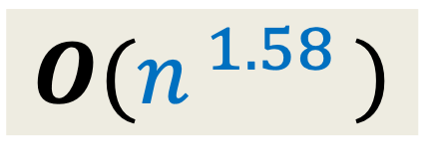
Fast Polynomial Multiplication
$$A\left(x\right)=A_{first}\left(x\right)+{ x}^{\frac{n}{2}} A_{second}\left(x\right)$$
$$B\left(x\right)=B_{first}\left(x\right)+{ x}^{\frac{n}{2}} B_{second}\left(x\right)$$
$A\left(x\right)×B\left(x\right)$ =
$$4 ×$$
Multiplication of $2$polynomials of degree $<n/2$
$T(n) = cn + 4 T(n/2)$
$$O(n^{ 1.58 })$$
$$3$$

Slide 6

Fast Matrix Multiplication
Divide each matrix into four n/2 $×$ n/2 matrices
2 | 3 | 0 | 3 | 7 | $$1$$
8 | 0 | 9 | 7 | 1 | $$4$$
0 | 0 | 4 | 0 | 0 | $$1$$
0 | 8 | 0 | 1 | 0 | $$7$$
5 | 3 | 0 | 5 | 0 | $$8$$
$$0$$ | $$11$$ | $$0$$ | $$9$$ | $$0$$ | $$2$$
A11
A12
0 | 0 | 5 | 0 | 6 | $$1$$
7 | 6 | 0 | 7 | 0 | 0
0 | 0 | 9 | 8 | 0 | 7
2 | 3 | 2 | 9 | 1 | 0
0 | 6 | 1 | 8 | 9 | 0
$$0$$ | 1 | 0 | 4 | 6 | 0
B11
B12
C11
C12
A21
A22
B21
B22
C21
C22
A
B
C
How to divide the problem instance ?

Slide 7

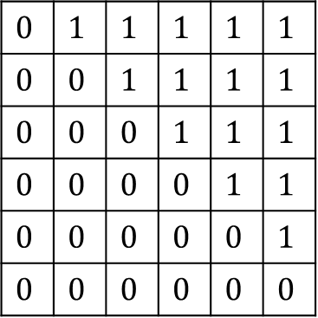


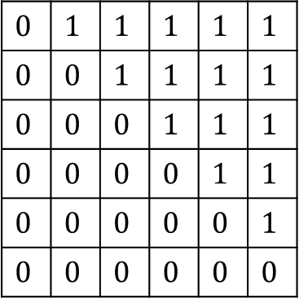

Fast Matrix Multiplication
Divide each matrix into four n/2 $×$ n/2 matrices
C11 = A11 $×$ B11 + A12 $×$ B21
C12 = A11 $×$ B12 + A12 $×$ B22
C21 = A21 $×$ B11 + A22 $×$ B21
C22 = A21 $×$ B12 + A22 $×$ B22
$$0$$ | $$1$$ | $$1$$ | $$1$$ | $$1$$ | $$1$$
$$0$$ | $$0$$ | $$1$$ | $$1$$ | $$1$$ | $$1$$
$$0$$ | $$0$$ | $$0$$ | $$1$$ | $$1$$ | $$1$$
$$0$$ | $$0$$ | $$0$$ | $$0$$ | $$1$$ | $$1$$
$$0$$ | $$0$$ | $$0$$ | $$0$$ | $$0$$ | $$1$$
$$0$$ | $$0$$ | $$0$$ | $$0$$ | $$0$$ | $$0$$
A11
A12
$$0$$ | $$1$$ | $$1$$ | $$1$$ | $$1$$ | $$1$$
$$0$$ | $$0$$ | $$1$$ | $$1$$ | $$1$$ | $$1$$
$$0$$ | $$0$$ | $$0$$ | $$1$$ | $$1$$ | $$1$$
$$0$$ | $$0$$ | $$0$$ | $$0$$ | $$1$$ | $$1$$
$$0$$ | $$0$$ | $$0$$ | $$0$$ | $$0$$ | $$1$$
$$0$$ | $$0$$ | $$0$$ | $$0$$ | $$0$$ | $$0$$
B11
B12
$$0$$ | $$1$$ | $$1$$ | $$1$$ | $$1$$ | $$1$$
$$0$$ | $$0$$ | $$1$$ | $$1$$ | $$1$$ | $$1$$
$$0$$ | $$0$$ | $$0$$ | $$1$$ | $$1$$ | $$1$$
$$0$$ | $$0$$ | $$0$$ | $$0$$ | $$1$$ | $$1$$
$$0$$ | $$0$$ | $$0$$ | $$0$$ | $$0$$ | $$1$$
$$0$$ | $$0$$ | $$0$$ | $$0$$ | $$0$$ | $$0$$
C11
C12
$$A_{i}$$
$$c_{ij}$$
$$B_{j}$$
A21
A22
B21
B22
C21
C22
A
B
C

Slide 8









Fast Matrix Multiplication
Divide each matrix into four n/2 $×$ n/2 matrices
C11 = A11 $×$ B11 + A12 $×$ B21
C12 = A11 $×$ B12 + A12 $×$ B22
C21 = A21 $×$ B11 + A22 $×$ B21
C22 = A21 $×$ B12 + A22 $×$ B22
$$T\left(n\right)= 8 T(n/2) + c n^{2}$$
$$0$$ | $$1$$ | $$1$$ | $$1$$ | $$1$$ | $$1$$
$$0$$ | $$0$$ | $$1$$ | $$1$$ | $$1$$ | $$1$$
$$0$$ | $$0$$ | $$0$$ | $$1$$ | $$1$$ | $$1$$
$$0$$ | $$0$$ | $$0$$ | $$0$$ | $$1$$ | $$1$$
$$0$$ | $$0$$ | $$0$$ | $$0$$ | $$0$$ | $$1$$
$$0$$ | $$0$$ | $$0$$ | $$0$$ | $$0$$ | $$0$$
A11
A12
$$0$$ | $$1$$ | $$1$$ | $$1$$ | $$1$$ | $$1$$
$$0$$ | $$0$$ | $$1$$ | $$1$$ | $$1$$ | $$1$$
$$0$$ | $$0$$ | $$0$$ | $$1$$ | $$1$$ | $$1$$
$$0$$ | $$0$$ | $$0$$ | $$0$$ | $$1$$ | $$1$$
$$0$$ | $$0$$ | $$0$$ | $$0$$ | $$0$$ | $$1$$
$$0$$ | $$0$$ | $$0$$ | $$0$$ | $$0$$ | $$0$$
B11
B12
$$0$$ | $$1$$ | $$1$$ | $$1$$ | $$1$$ | $$1$$
$$0$$ | $$0$$ | $$1$$ | $$1$$ | $$1$$ | $$1$$
$$0$$ | $$0$$ | $$0$$ | $$1$$ | $$1$$ | $$1$$
$$0$$ | $$0$$ | $$0$$ | $$0$$ | $$1$$ | $$1$$
$$0$$ | $$0$$ | $$0$$ | $$0$$ | $$0$$ | $$1$$
$$0$$ | $$0$$ | $$0$$ | $$0$$ | $$0$$ | $$0$$
C11
C12
A21
A22
B21
B22
C21
C22
A
B
C
$8$ multiplications & $4$ additions of $\frac{n}{2}×\frac{n}{2}$ matrices
Volker Strassen, 1969
$7$ multiplications
& $18$ additions/subtractions of $\frac{n}{2}×\frac{n}{2}$ matrices
$$7$$
$$=Θ(n^{\log_{2} 8})$$
$$=Θ(n^{3})$$
$$=Θ(n^{\log_{2} 7})$$
$$=Θ(n^{2.81})$$

Slide 9



Fast Matrix Multiplication
Volker Strassen, 1969
$$=Θ(n^{2.81})$$
Virginia Vassilevska Williams, 2020
$$=Θ(n^{2.37286})$$
$ω=2.37286$

Slide 10
Amazing Applications of
Fast Matrix Multiplication

Slide 11
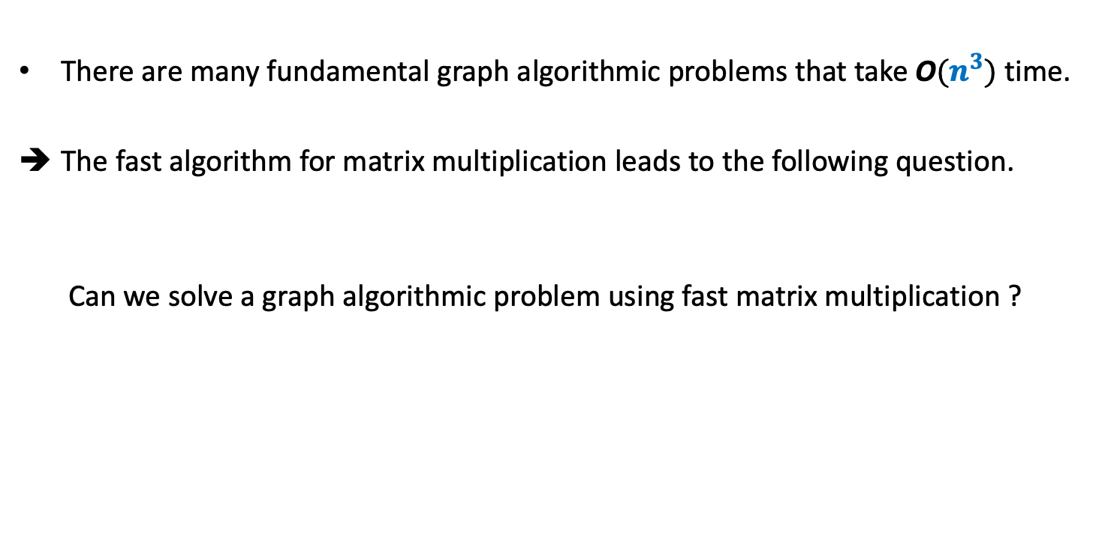
There are many fundamental graph algorithmic problems that take O$(n^{3})$ time.
The fast algorithm for matrix multiplication leads to the following question.
Can we solve a graph algorithmic problem using fast matrix multiplication ?

Slide 12
But why did anyone think of this approach ?
There must have been some obvious connection between graphs and matrices.
Indeed, there is such a connection.
Can you spot it ?
Answer:
Each graph is represented as an adjacency matrix.
But which matrices should be multiplied to solve a given graph problem ?
Let us explore what we get if we multiply the adjacency matrix with itself.

Slide 13







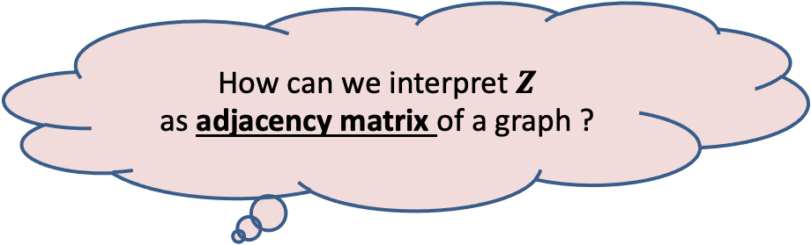
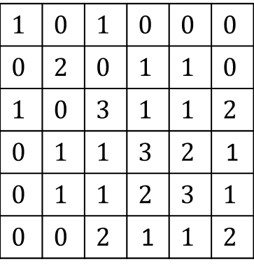




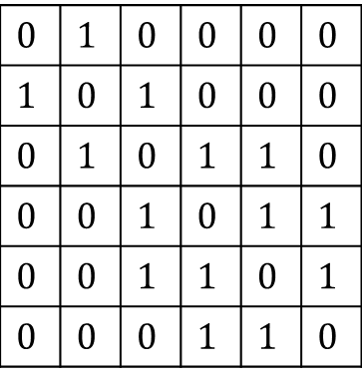

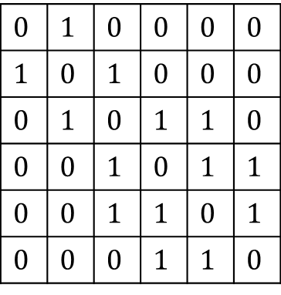


$$1$$ | $$2$$ | $$3$$ | $$4$$ | $$5$$ | $$6$$
$$1$$
$$2$$
$$3$$
$$4$$
$$5$$
$$6$$
$$0$$ | $$1$$ | $$0$$ | $$0$$ | $$0$$ | $$0$$
$$1$$ | $$0$$ | $$1$$ | $$0$$ | $$0$$ | $$0$$
$$0$$ | $$1$$ | $$0$$ | $$1$$ | $$1$$ | $$0$$
$$0$$ | $$0$$ | $$1$$ | $$0$$ | $$1$$ | $$1$$
$$0$$ | $$0$$ | $$1$$ | $$1$$ | $$0$$ | $$1$$
$$0$$ | $$0$$ | $$0$$ | $$1$$ | $$1$$ | $$0$$
$$0$$ | $$1$$ | $$0$$ | $$0$$ | $$0$$ | $$0$$
$$1$$ | $$0$$ | $$1$$ | $$0$$ | $$0$$ | $$0$$
$$0$$ | $$1$$ | $$0$$ | $$1$$ | $$1$$ | $$0$$
$$0$$ | $$0$$ | $$1$$ | $$0$$ | $$1$$ | $$1$$
$$0$$ | $$0$$ | $$1$$ | $$1$$ | $$0$$ | $$1$$
$$0$$ | $$0$$ | $$0$$ | $$1$$ | $$1$$ | $$0$$
$$1$$ | $$0$$ | $$1$$ | $$0$$ | $$0$$ | $$0$$
$$0$$ | $$2$$ | $$0$$ | $$1$$ | $$1$$ | $$0$$
$$1$$ | $$0$$ | $$3$$ | $$1$$ | $$1$$ | $$2$$
$$0$$ | $$1$$ | $$1$$ | $$3$$ | $$2$$ | 1
$$0$$ | $$1$$ | $$1$$ | $$2$$ | $$3$$ | $$1$$
$$0$$ | $$0$$ | $$2$$ | 1 | $$1$$ | $$2$$
$$0$$
$$0$$
$$0$$
$$1$$
𝒁 has diagonal entries non-zero.
𝒁 has some entries which are not 0-1.
Let us solve the first graph algorithmic problem now.
$$0$$
$$1$$
$$1$$
$$0$$
$$1$$
$$0$$
$$A$$
$$A$$
$$B$$
$$Z$$
How can we interpret $Z$
as adjacency matrix of a graph ?

Slide 14

All Pairs Reachability
BFS or DFS
➔ O$(n^{3})$ in the worst case.
Time complexity for APR: O$(n^{ω})$ time.

Slide 15
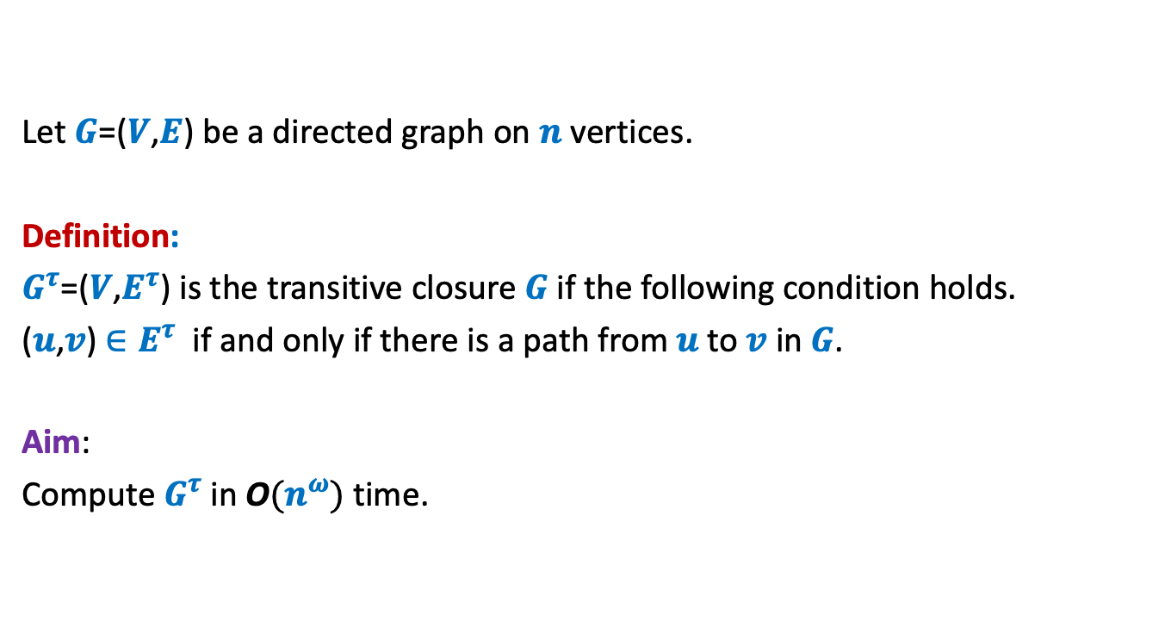
Transitive Closure of Graph
Let $G$=($V$,$E$) be a directed graph on $n$ vertices.
Definition:
$G^{τ}$=($V$,$E^{τ}$) is the transitive closure $G$if the following condition holds.
($u$,$v$) $∈E^{τ}$ if and only if there is a path from $u$to $v$ in $G$.
Aim:
Compute $G^{τ}$in O$(n^{ω})$ time.

Slide 16






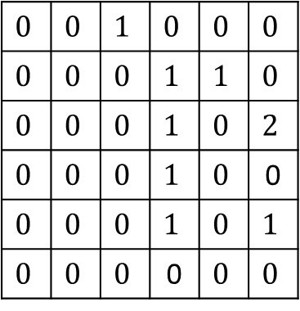
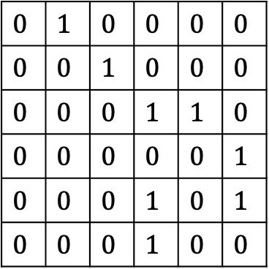

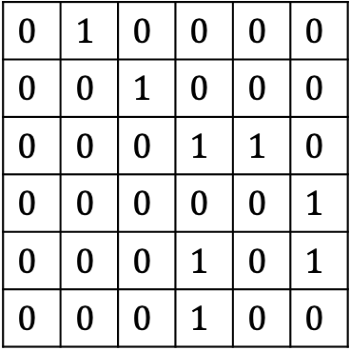







$$1$$ | $$2$$ | $$3$$ | $$4$$ | $$5$$ | $$6$$
$$1$$ | $$2$$ | $$3$$ | $$4$$ | $$5$$ | $$6$$
$$1$$
$$2$$
$$3$$
$$4$$
$$5$$
$$6$$
$$0$$ | $$1$$ | $$0$$ | $$0$$ | $$0$$ | $$0$$
$$0$$ | $$0$$ | $$1$$ | $$0$$ | $$0$$ | $$0$$
$$0$$ | $$0$$ | $$0$$ | $$1$$ | $$1$$ | $$0$$
$$0$$ | $$0$$ | $$0$$ | $$0$$ | $$0$$ | $$1$$
$$0$$ | $$0$$ | $$0$$ | $$1$$ | $$0$$ | $$1$$
$$0$$ | $$0$$ | $$0$$ | $$1$$ | $$0$$ | $$0$$
$$0$$ | $$1$$ | $$0$$ | $$0$$ | $$0$$ | $$0$$
$$0$$ | $$0$$ | $$1$$ | $$0$$ | $$0$$ | $$0$$
$$0$$ | $$0$$ | $$0$$ | $$1$$ | $$1$$ | $$0$$
$$0$$ | $$0$$ | $$0$$ | $$0$$ | $$0$$ | $$1$$
$$0$$ | $$0$$ | $$0$$ | $$1$$ | $$0$$ | $$1$$
$$0$$ | $$0$$ | $$0$$ | $$1$$ | $$0$$ | $$0$$
$$1$$
$$2$$
$$3$$
$$4$$
$$5$$
$$6$$
$$0$$ | $$0$$ | $$1$$ | $$0$$ | $$0$$ | $$0$$
$$0$$ | $$0$$ | $$0$$ | $$1$$ | $$1$$ | $$0$$
$$0$$ | $$0$$ | $$0$$ | $$1$$ | $$0$$ | $$2$$
$$0$$ | $$0$$ | $$0$$ | $$1$$ | $$0$$ | 0
$$0$$ | $$0$$ | $$0$$ | $$1$$ | $$0$$ | $$1$$
$$0$$ | $$0$$ | $$0$$ | 0 | $$0$$ | $$0$$
$$A$$
$$A$$
$$Z$$
$$4$$
$$6$$
$$1$$
$$2$$
$$3$$
$$5$$
$$G$$

Slide 17

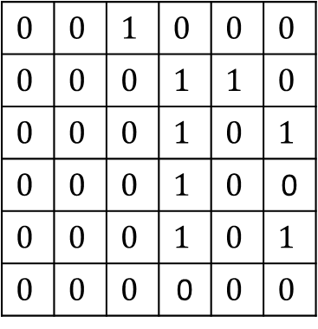
$$1$$ | $$2$$ | $$3$$ | $$4$$ | $$5$$ | $$6$$
$$1$$ | $$2$$ | $$3$$ | $$4$$ | $$5$$ | $$6$$
$$1$$
$$2$$
$$3$$
$$4$$
$$5$$
$$6$$
$$0$$ | $$1$$ | $$0$$ | $$0$$ | $$0$$ | $$0$$
$$0$$ | $$0$$ | $$1$$ | $$0$$ | $$0$$ | $$0$$
$$0$$ | $$0$$ | $$0$$ | $$1$$ | $$1$$ | $$0$$
$$0$$ | $$0$$ | $$0$$ | $$0$$ | $$0$$ | $$1$$
$$0$$ | $$0$$ | $$0$$ | $$1$$ | $$0$$ | $$1$$
$$0$$ | $$0$$ | $$0$$ | $$1$$ | $$0$$ | $$0$$
$$0$$ | $$1$$ | $$0$$ | $$0$$ | $$0$$ | $$0$$
$$0$$ | $$0$$ | $$1$$ | $$0$$ | $$0$$ | $$0$$
$$0$$ | $$0$$ | $$0$$ | $$1$$ | $$1$$ | $$0$$
$$0$$ | $$0$$ | $$0$$ | $$0$$ | $$0$$ | $$1$$
$$0$$ | $$0$$ | $$0$$ | $$1$$ | $$0$$ | $$1$$
$$0$$ | $$0$$ | $$0$$ | $$1$$ | $$0$$ | $$0$$
$$1$$
$$2$$
$$3$$
$$4$$
$$5$$
$$6$$
$$0$$ | $$0$$ | $$1$$ | $$0$$ | $$0$$ | $$0$$
$$0$$ | $$0$$ | $$0$$ | $$1$$ | $$1$$ | $$0$$
$$0$$ | $$0$$ | $$0$$ | $$1$$ | $$0$$ | $$1$$
$$0$$ | $$0$$ | $$0$$ | $$1$$ | $$0$$ | 0
$$0$$ | $$0$$ | $$0$$ | $$1$$ | $$0$$ | $$1$$
$$0$$ | $$0$$ | $$0$$ | 0 | $$0$$ | $$0$$
$$A$$
$$A$$
$$B$$
$$4$$
$$6$$
$$1$$
$$2$$
$$3$$
$$5$$
$$G$$

Slide 18







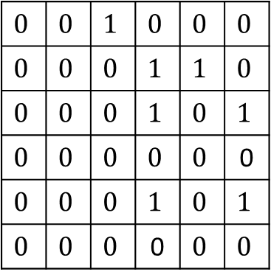





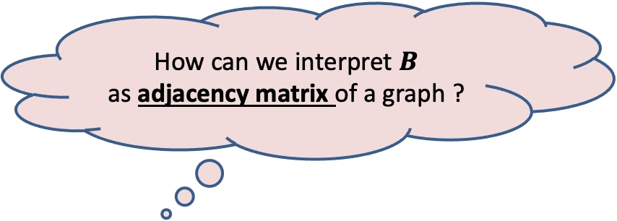
$$1$$ | $$2$$ | $$3$$ | $$4$$ | $$5$$ | $$6$$
$$1$$ | $$2$$ | $$3$$ | $$4$$ | $$5$$ | $$6$$
$$1$$
$$2$$
$$3$$
$$4$$
$$5$$
$$6$$
$$0$$ | $$1$$ | $$0$$ | $$0$$ | $$0$$ | $$0$$
$$0$$ | $$0$$ | $$1$$ | $$0$$ | $$0$$ | $$0$$
$$0$$ | $$0$$ | $$0$$ | $$1$$ | $$1$$ | $$0$$
$$0$$ | $$0$$ | $$0$$ | $$0$$ | $$0$$ | $$1$$
$$0$$ | $$0$$ | $$0$$ | $$1$$ | $$0$$ | $$1$$
$$0$$ | $$0$$ | $$0$$ | $$1$$ | $$0$$ | $$0$$
$$0$$ | $$1$$ | $$0$$ | $$0$$ | $$0$$ | $$0$$
$$0$$ | $$0$$ | $$1$$ | $$0$$ | $$0$$ | $$0$$
$$0$$ | $$0$$ | $$0$$ | $$1$$ | $$1$$ | $$0$$
$$0$$ | $$0$$ | $$0$$ | $$0$$ | $$0$$ | $$1$$
$$0$$ | $$0$$ | $$0$$ | $$1$$ | $$0$$ | $$1$$
$$0$$ | $$0$$ | $$0$$ | $$1$$ | $$0$$ | $$0$$
$$1$$
$$2$$
$$3$$
$$4$$
$$5$$
$$6$$
$$0$$ | $$0$$ | $$1$$ | $$0$$ | $$0$$ | $$0$$
$$0$$ | $$0$$ | $$0$$ | $$1$$ | $$1$$ | $$0$$
$$0$$ | $$0$$ | $$0$$ | $$1$$ | $$0$$ | $$1$$
$$0$$ | $$0$$ | $$0$$ | $$0$$ | $$0$$ | 0
$$0$$ | $$0$$ | $$0$$ | $$1$$ | $$0$$ | $$1$$
$$0$$ | $$0$$ | $$0$$ | 0 | $$0$$ | $$0$$
There is an edge ($i,j$) in the graph corresponding to $B$
if and only if there is a path of length 2 from $i$ to $j$ in $G$.
$$A$$
$$A$$
$$B$$
$$4$$
$$4$$
How can we interpret $B$
as adjacency matrix of a graph ?
$$6$$
$$6$$
$$1$$
$$2$$
$$3$$
$$1$$
$$2$$
$$3$$
Hint:
What if we add the missing edges from $G$ ?
$$5$$
$$5$$
$$G$$
𝑩$\left[i,j\right]=1$ if
$∃k$ such that
$A\left[i,k\right]=1$and $A\left[k,j\right]=1$

Slide 19

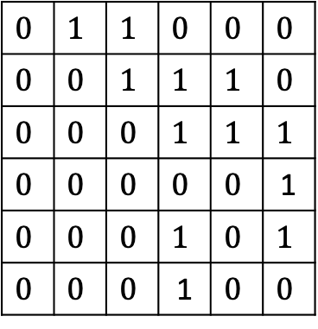


$$1$$ | $$2$$ | $$3$$ | $$4$$ | $$5$$ | $$6$$
$$1$$ | $$2$$ | $$3$$ | $$4$$ | $$5$$ | $$6$$
$$1$$
$$2$$
$$3$$
$$4$$
$$5$$
$$6$$
$$0$$ | $$1$$ | $$0$$ | $$0$$ | $$0$$ | $$0$$
$$0$$ | $$0$$ | $$1$$ | $$0$$ | $$0$$ | $$0$$
$$0$$ | $$0$$ | $$0$$ | $$1$$ | $$1$$ | $$0$$
$$0$$ | $$0$$ | $$0$$ | $$0$$ | $$0$$ | $$1$$
$$0$$ | $$0$$ | $$0$$ | $$1$$ | $$0$$ | $$1$$
$$0$$ | $$0$$ | $$0$$ | $$1$$ | $$0$$ | $$0$$
$$0$$ | $$1$$ | $$0$$ | $$0$$ | $$0$$ | $$0$$
$$0$$ | $$0$$ | $$1$$ | $$0$$ | $$0$$ | $$0$$
$$0$$ | $$0$$ | $$0$$ | $$1$$ | $$1$$ | $$0$$
$$0$$ | $$0$$ | $$0$$ | $$0$$ | $$0$$ | $$1$$
$$0$$ | $$0$$ | $$0$$ | $$1$$ | $$0$$ | $$1$$
$$0$$ | $$0$$ | $$0$$ | $$1$$ | $$0$$ | $$0$$
$$1$$
$$2$$
$$3$$
$$4$$
$$5$$
$$6$$
$$0$$ | $$1$$ | $$1$$ | $$0$$ | $$0$$ | $$0$$
$$0$$ | $$0$$ | $$1$$ | $$1$$ | $$1$$ | $$0$$
$$0$$ | $$0$$ | $$0$$ | $$1$$ | $$1$$ | $$1$$
$$0$$ | $$0$$ | $$0$$ | $$0$$ | $$0$$ | 1
$$0$$ | $$0$$ | $$0$$ | $$1$$ | $$0$$ | $$1$$
$$0$$ | $$0$$ | $$0$$ | 1 | $$0$$ | $$0$$
There is an edge ($i,j$) in the graph corresponding to $B$
if and only if there is a path of length 2 from $i$ to $j$ in $G$.
$$A$$
$$A$$
$$B$$
at most 2 from $i$ to $j$ in $G$.
$$4$$
$$4$$
$$6$$
$$6$$
$$1$$
$$2$$
$$3$$
$$1$$
$$2$$
$$3$$
$$5$$
$$5$$
$$G$$
$$G^{2}$$

Slide 20











$$1$$ | $$2$$ | $$3$$ | $$4$$ | $$5$$ | $$6$$
$$1$$ | $$2$$ | $$3$$ | $$4$$ | $$5$$ | $$6$$
$$1$$
$$2$$
$$3$$
$$4$$
$$5$$
$$6$$
$$0$$ | $$1$$ | $$0$$ | $$0$$ | $$0$$ | $$0$$
$$0$$ | $$0$$ | $$1$$ | $$0$$ | $$0$$ | $$0$$
$$0$$ | $$0$$ | $$0$$ | $$1$$ | $$1$$ | $$0$$
$$0$$ | $$0$$ | $$0$$ | $$0$$ | $$0$$ | $$1$$
$$0$$ | $$0$$ | $$0$$ | $$1$$ | $$0$$ | $$1$$
$$0$$ | $$0$$ | $$0$$ | $$1$$ | $$0$$ | $$0$$
$$0$$ | $$1$$ | $$0$$ | $$0$$ | $$0$$ | $$0$$
$$0$$ | $$0$$ | $$1$$ | $$0$$ | $$0$$ | $$0$$
$$0$$ | $$0$$ | $$0$$ | $$1$$ | $$1$$ | $$0$$
$$0$$ | $$0$$ | $$0$$ | $$0$$ | $$0$$ | $$1$$
$$0$$ | $$0$$ | $$0$$ | $$1$$ | $$0$$ | $$1$$
$$0$$ | $$0$$ | $$0$$ | $$1$$ | $$0$$ | $$0$$
$$1$$
$$2$$
$$3$$
$$4$$
$$5$$
$$6$$
$$0$$ | $$1$$ | $$1$$ | $$0$$ | $$0$$ | $$0$$
$$0$$ | $$0$$ | $$1$$ | $$1$$ | $$1$$ | $$0$$
$$0$$ | $$0$$ | $$0$$ | $$1$$ | $$1$$ | $$1$$
$$0$$ | $$0$$ | $$0$$ | $$0$$ | $$0$$ | 1
$$0$$ | $$0$$ | $$0$$ | $$1$$ | $$0$$ | $$1$$
$$0$$ | $$0$$ | $$0$$ | 1 | $$0$$ | $$0$$
Question:
How to compute $G^{3}$ ?
Question:
How to compute $G^{4}$ ?
Question:
How to compute Transitive Closure ?
$$A$$
$$A$$
$$B$$
Compute $A × B$
and take union with $B$
Let $B′$ be the Adjacency Matrix of $G^{3}$
Compute $B × B$
and take union with $B$
Compute $A × B′$
and take union with $B′$
Compute $G^{n−1}$
$n−1$ Matrix Multiplications ☹
Hint: Can we compute $G^{4}$ from $G^{2}$ in a single matrix multiplication than 2 multiplications ?

Slide 21





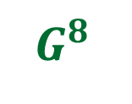
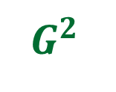
Theorem:
We can compute transitive closure of graph $G$ in O$(n^{ω} log n)$ time.
$$G$$
$\log{n}$ Matrix Multiplications ☺
$G^{2}$
$G^{4}$
$G^{8}$
…
$$G^{n−1}$$
How to eliminate the $log n$ factor ?

Slide 22
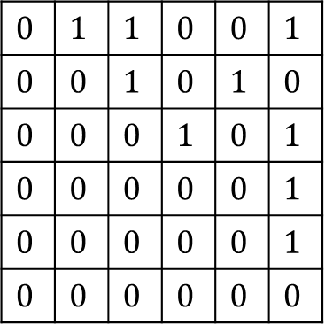
Make use of the SCC graph
SCC graph is a DAG.
Question: How does its Adjacency Matrix look like ?
Answer: Nothing special ☹
Question: What if you relabel the vertices according to topological ordering?
Answer: Upper Triangular Matrix
0
$$0$$ | $$1$$ | $$1$$ | $$0$$ | $$0$$ | $$1$$
$$0$$ | $$0$$ | $$1$$ | $$0$$ | $$1$$ | $$0$$
$$0$$ | $$0$$ | $$0$$ | $$1$$ | $$0$$ | $$1$$
$$0$$ | $$0$$ | $$0$$ | $$0$$ | $$0$$ | $$1$$
$$0$$ | $$0$$ | $$0$$ | $$0$$ | $$0$$ | $$1$$
$$0$$ | $$0$$ | $$0$$ | $$0$$ | $$0$$ | $$0$$

Slide 23

Make use of the SCC graph
0
$$0$$ | $$1$$ | $$1$$ | $$0$$ | $$0$$ | $$1$$
$$0$$ | $$0$$ | $$1$$ | $$0$$ | $$1$$ | $$0$$
$$0$$ | $$0$$ | $$0$$ | $$1$$ | $$0$$ | $$1$$
$$0$$ | $$0$$ | $$0$$ | $$0$$ | $$0$$ | $$1$$
$$0$$ | $$0$$ | $$0$$ | $$0$$ | $$0$$ | $$1$$
$$0$$ | $$0$$ | $$0$$ | $$0$$ | $$0$$ | $$0$$
A12
Homework:
Ponder over efficient ways to compute transitive closure of $G$ in
O$(n^{ω})$ time.
A11
0
A22

Slide 24
Next lecture
We shall discuss a more interesting application of Matrix Multiplication.
Go to the next slide to know about this application.

Slide 25

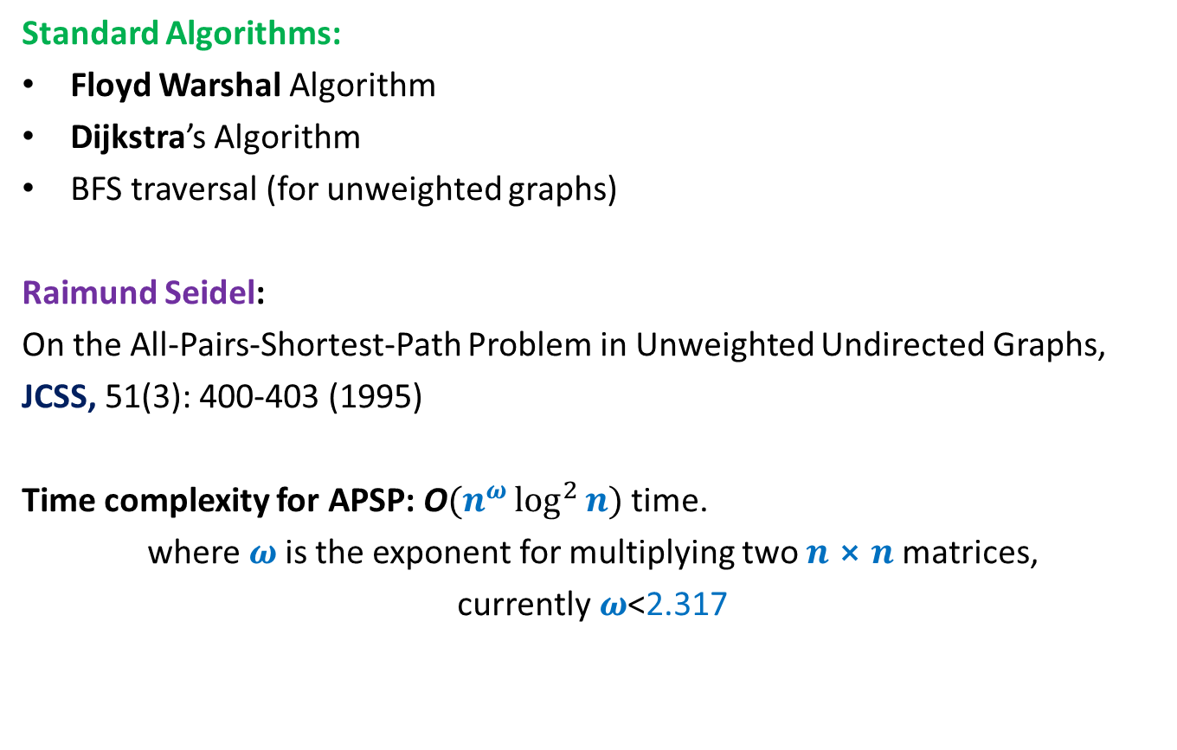
All Pairs Shortest Paths (APSP)
Matrix Multiplication
Standard Algorithms:
Floyd Warshal Algorithm
Dijkstra’s Algorithm
BFS traversal (for unweighted graphs)
Raimund Seidel:
On the All-Pairs-Shortest-Path Problem in Unweighted Undirected Graphs,
JCSS, 51(3): 400-403 (1995)
Time complexity for APSP: O$(n^{ω}\log^{2}{n})$ time.
where $ω$is the exponent for multiplying two $n⨯n$matrices,
currently$ω$<2.317
O$(n^{3})$ time in the worst case

